Slide 1
From Design to Delivery
A Software Engineer's Handbook

Slide 2



Yanisa Khambanonda
Software Engineer
2 years @ Bloomberg
Angela Sun
Software Engineer
3 years @ Bloomberg
Shuzhan Yang
Software Engineer
2 years @ Bloomberg

Slide 3
Agenda - The SDLC Journey
Design
Plan
Development
Testing
Deployment
Monitoring & Debugging
“
Walks you through the steps of designing and delivering a software application from start to finish
”

Slide 4
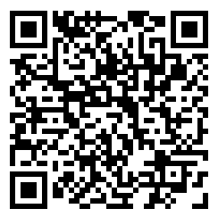
Join our PollEverywhere
PollEv.com/ghc502
Our slides and workbook can be found at: https://github.com/angelasun2/GHC23

Slide 5
PollEverywhere: How are you feeling today?

Slide 6


Client Requirements
Who determines these? people who pay for the product, a PM, other engineers
What are the requirements? usage patterns, expected behavior, business logic
When do they get added? ideally as early as possible, realistically, all the time
Where do we track them? various tools like agreement documents, project specifications, mock-ups, Jira
How should we proceed? prioritize and scope

Slide 7
Project Introduction
ChatGHC

Slide 8



Our Client Requirements
Who: Surveyed GHC’22 participants
What: A chatbot to answer questions about GHC’23!
Simple text Q&A automated bot
Chat history up to 1 month
Tens of thousands of clients using this chatbot around the world

Slide 9
Designing
Draft a System Diagram
Design
Plan
Development
Testing
Deployment
Monitoring & Debugging

Slide 10
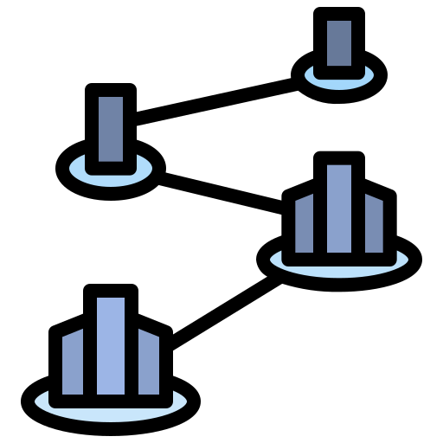


Design Values
Different teams and businesses may have different values/considerations:
Reliability: Trading system
Timeliness: Real time gaming
Speed of Development: A new startup
Maintainability: Healthcare services
In this session, we will focus on maintainability and incremental delivery

Slide 11


Technical Considerations
Simplicity → decoupled, single-responsibility
Scalability → how to grow without impacting the system
Reusability → can we reuse this in the future?
Tech stack considerations → what do we already have?
Community → is it easy to get help or questions answered? Is it a well-documented technology?

Slide 12
Overview of Component Types
Back-end:
Database: a permanent, large data store
Cache: A smaller, quick-access data store that’s usually a subset of a database. Must be refreshed if filled up
Load balancer: A filter-like component that distributes requests to different instances of services so any one doesn’t become overloaded
Services: A collection of code that is always accessible, ready to accept requests, perform an action, and return a response

Slide 13
Overview of Component Types
Middleware:
Queue: A collection of messages stored in a first in-first out (FIFO) pattern, usually used to communicate between services
Logging: A mechanism to track what happened and what’s happening in real-time in a component; for debugging, visibility, possible crash prevention, etc.
Routing (HTTP/GraphQL/etc.): Various network protocols to send/receive requests and responses depending on various factors - traffic, data format, etc.
Deployments:
Local: On one machine, usually your development machine
Datacenter: Many machines in one location that your app can run multiple instances on
Cloud: Many machines in many locations that your app can scale even more instances on

Slide 14











Overview of Component Types
Back-end:
Database
Cache
Load balancer
Services
AI Model
Middleware:
Queue
Logging
Routing (HTTP/GraphQL/etc.)
Deployments::
Local
Datacenter
Cloud
SVC

Slide 15
Workbook Activity
Draw a system design diagram

Slide 16
An Example: Iteration 1
Database
<UI>
Web interface
Web Server
AI Response Service
(third-party)
localhost:5000
Tables:
Chats
Users
localhost:3000
https://exampleservice.com/response

Slide 17
PollEverywhere: Suggest some improvements

Slide 18
An Example: Iteration 2
database
database
Chat Service
Database with replicas
Local Cache
Router
<UI>
Web interface
Web Server
www.chatghc.com/chat
AI Response Service
(third-party)
www.chatghc.com
History Service
https://exampleservice.com/response

Slide 19
Things to consider
Iteration is critical
Design reviews within the team and outside the team
Design will change in other phases of the SDLC
Start simple
Just one feature end-to-end. It’s easier to add rather than remove components!
Don’t over-engineer
Have expandability in mind

Slide 20
Planning
Translate the design into milestones and deliverables
Design
Plan
Development
Testing
Deployment
Monitoring & Debugging

Slide 21
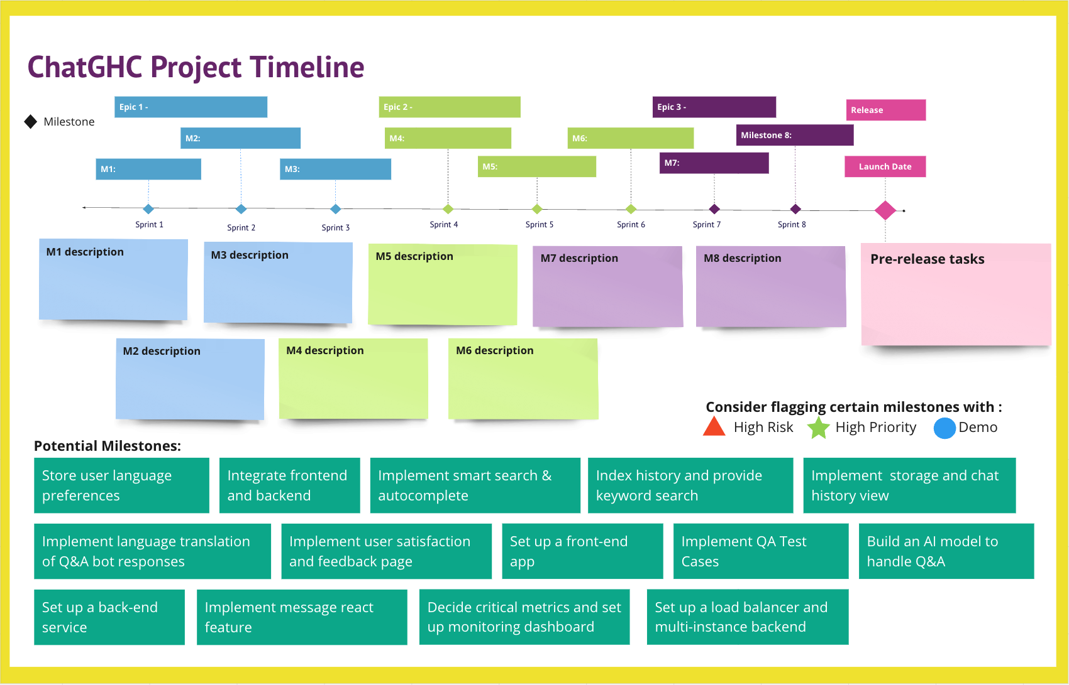
Let’s create a Project Timeline
Things to consider :
Agile development
Initiatives
Epics
Milestones
Time & scope
Beta and Production deadlines
Demos
Testing
Pre-release tasks

Slide 22
Workbook Activity
Create a timeline with milestones and dates
Assumptions:
Team members: 3 Software Developers
External Support: Product Managers, UX Designers, Quality Assurance (QA) Testers
Deadline: 3 months

Slide 23
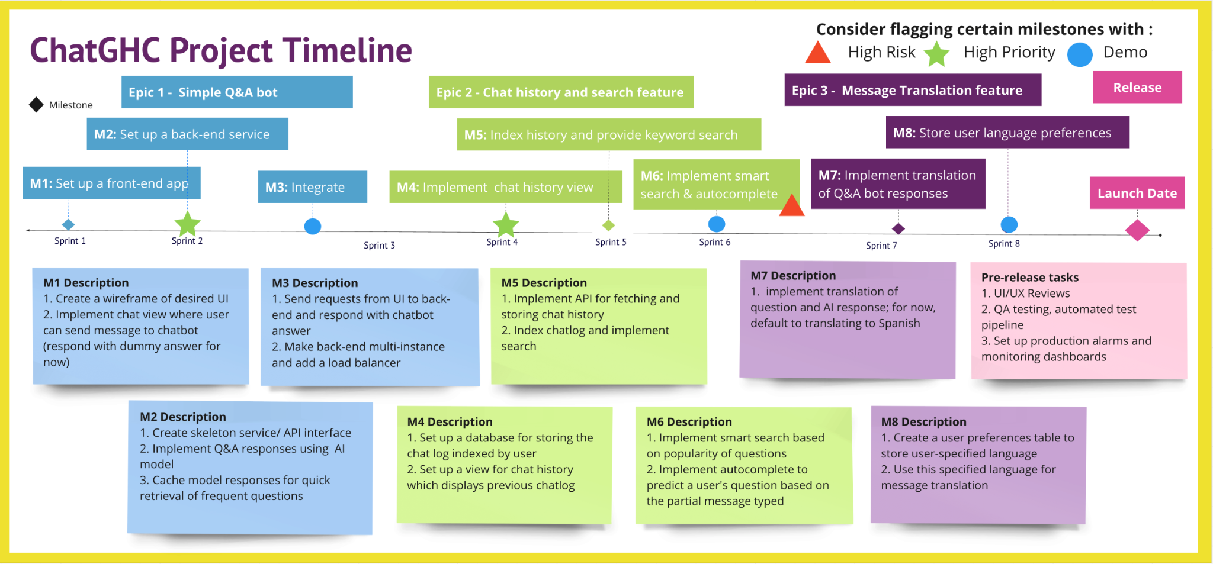

Slide 24
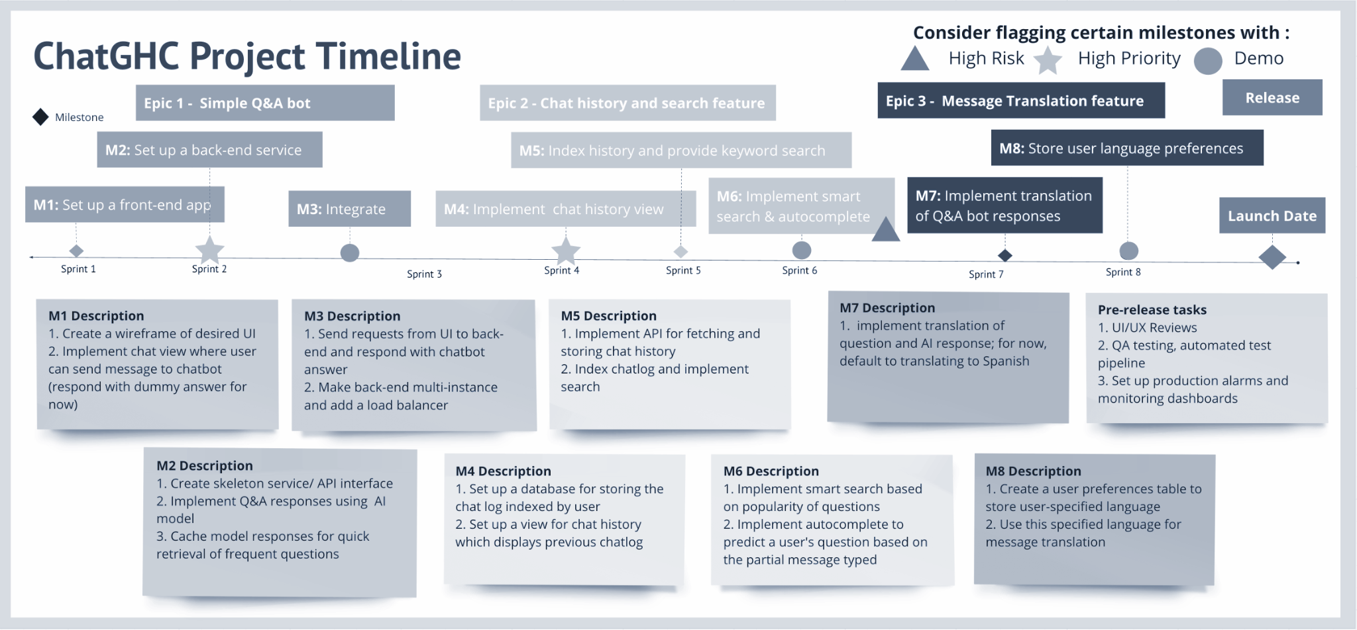

Slide 26
Things to consider
Planning
Balance between having a buffer and over-estimating
Keep scope of project clear – prevent scope-creeping (adding new features midway through)
Ask for feedback from a mentor on your estimated times
Execution
Be transparent with communication throughout the lifecycle if things are taking longer / shorter than estimated
Clarify expectations for each deliverables before hand

Slide 27
Testing
Implementing Tests
Design
Plan
Development
Testing
Deployment
Monitoring & Debugging

Slide 28



Types of tests
Unit Tests
Verifies functionality of a single component in isolation
Ideally, mocks out external dependencies/side effects
Useful for Test-driven Development (TDD)
Integration Tests
Verifies how parts of your system work together
Tests side effects and connections to external dependencies (i.e., databases, client APIs)
Catches interface errors between different components
System Tests
Verifies your software functions correctly as a whole
Tests entire workflows and client use cases
Helps identify errors in the system
Can include non-functional testing (e.g., performance, usability, scalability)

Slide 29
PollEverywhere: What kind of test is this?
“
I want to stress test the chatbot by sending 100 messages to the Q&A bot every minute for 10 minutes.
”

Slide 30
PollEverywhere: What kind of test is this?
System Tests
“
I want to stress test the chatbot by sending 100 messages to the Q&A bot every minute for 10 minutes.
”

Slide 31
PollEverywhere: What kind of test is this?
“
I want to make sure that the chatHistorySvc can fetch the right data from the chatLogDatabase.
”

Slide 32
PollEverywhere: What kind of test is this?
Integration Tests
“
I want to make sure that the chatHistorySvc can fetch the right data from the chatLogDatabase.
”

Slide 33
PollEverywhere: What kind of test is this?
“
I want to to make sure my chatMessageParser is able to take an incoming user message and remove any unsupported ASCII characters from the text.
”

Slide 34
PollEverywhere: What kind of test is this?
Unit Tests
“
I want to to make sure my chatMessageParser is able to take an incoming user message and remove any unsupported ASCII characters from the text.
”

Slide 35
Things to consider
Try to automate when possible
Schedule automated system tests to run periodically
Integrate unit tests into CI/CD pipelines such as Jenkins
Code with testability in mind
Design mockable classes and make use of dependency injection
Create readable, easily debuggable unit tests
Create reliable tests
Don’t just focus on “the happy path” – test negative cases
Consider and verify side effects

Slide 36
Deploying
Create a Release Plan
Design
Plan
Development
Testing
Deployment
Monitoring & Debugging

Slide 37

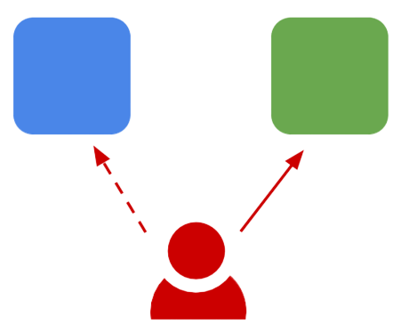

Types of Deployment
Full Deployment
Release all components to everyone at the same time
Simple, fast, cheap
Use for low-risk or non-critical releases
Riskiest: difficult to rollback
Blue-Green Deployment
Deploy to a staging environment and test before switching users to this environment
Easy to rollback
Expensive to maintain a replicated production environment
Canary Deployment
Incrementally release application to subsets of users by stages
Allows testing of real user traffic and side-by-side comparison of different service versions
Fast and safe to rollback
Complicated to implement

Slide 38
Workbook Activity
Match the deployment strategy to the appropriate situation

Slide 39
Workbook Activity
Situation A
“
The MVP of ChatGHC has to go out to production in 1 week. We don’t have any deployment tooling set up yet, and will likely only have 10% of expected traffic since our marketing team has not yet announced an official launch of this app.
Full Deployment
”

Slide 40
Workbook Activity
Situation B
“
We have 1 month till ChatGHC’s release. This will be a large release with seven microservices, new databases, and critical features! We already have over two thousand clients using our app, so it’d be great to release this seamlessly without causing issues to these clients. Our QA team has also created some test cases to verify the functionality of these new features.
Blue Green Deployment
”

Slide 41
Workbook Activity
Situation C
“
In two weeks, we want to release the searchable chat history feature. This is a highly requested feature, but we want to be conservative with the release to ensure our big clients don’t experience any problems or outages. It would be nice to have our smaller clients try out this workflow in production before introducing it to our big clients.
Canary Deployment
”

Slide 42
Workbook Activity
Situation D
“
The translation service is now ready for deployment! This service will help our Spanish-speaking users translate the messages from English to Spanish, but it should not impact any other functionality or services.
Full Deployment
”

Slide 43
Things to consider
Choose the right deployment strategy based on your situation
Consider system criticality, available resources, timeline, expected release frequency, etc.
Create a release plan and discuss rollback strategies early
Document these somewhere for others to reference

Slide 44
Monitoring & Debugging
Gathering metrics and tips for debugging
Design
Plan
Development
Testing
Deployment
Monitoring & Debugging

Slide 45


Metrics
Engineering
Platform Metrics: Requests per second, Failed requests per second
Resource Metrics: CPU and memory utilization, Host count, Live threads, Heap usage
Golden Signals: Availability, Request rate, Latency, Saturation
Business
Functionality Metrics: Percentage of questions the chatbot knows the answer to, Conversation volumes
Performance Metrics: Relevance of chatbot answers, Speed of response
Satisfaction Metrics: Satisfaction scores, Ratings by users, User retention

Slide 46
PollEverywhere: What metrics to collect?
“
Engineers need to receive alerts if 30% of the chat server is slow, unhealthy or down.
”

Slide 47
PollEverywhere: What metrics to collect?
Engineering Metrics
Database connection failure
Memory consumption saturation
Service availability in the network
“
Engineers need to receive alerts if 30% of the chat server is slow, unhealthy or down.
”

Slide 48
PollEverywhere: What metrics to collect?
“
Data scientists need to measure how well the chatbot understands human questions.
”

Slide 49
PollEverywhere: What metrics to collect?
Business Metrics
Relevance score
Flow completion rate
“
Data scientists need to measure how well the chatbot understands human questions.
”

Slide 50
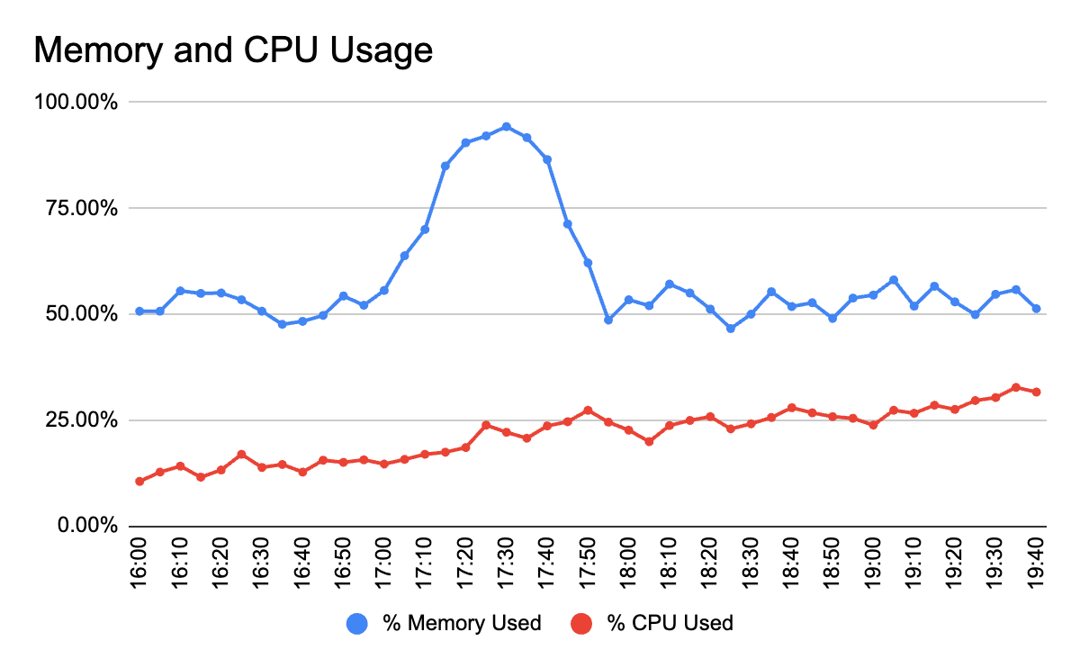
PollEverywhere: What’s concerning in the dashboard?

Slide 51
PollEverywhere: What’s concerning in the dashboard?

Slide 52
PollEverywhere: What’s concerning in the logs?

Slide 53
 | timestamp | level | message
1 | 2023-09-01 14:00:01.074 | INFO | chatbot_app.py:13 Incoming request from uuid=439323 request = { sessionID: a3nf8s3, question: “How do I get to the convention centre from Rosen Plaza Hotel?” }
2 | 2023-09-01 14:00:01.083 | DEBUG | chatbot_model.py:27 Generating chatbot response….
3 | 2023-09-01 14:00:02.192 | INFO | chatbot_model.py:32 Response found for question: “How do I get to the convention centre from Rosen Plaza Hotel?”, answer: “To get to the GHC convention centre from Rosen Plaza Hotel please follow these directions: www.tinyurl.com/12$wkds239rfj35. This is a 10 minute walk.”
4 | 2023-09-01 14:00:02.554 | INFO | chatbot_user.py:68 User settings for uuid=439323 found name=”Sarah Smith”, defaultLanguage=e_SPANISH, isGHCPresenter=false, GHCId=null
5 | 2023-09-01 14:00:02.555 | WARN | chatbot_response.py:401 This user has not specified their GHCId
6 | 2023-09-01 14:00:02.640 | INFO | chatbot_repsonse.py:432 Sending chatbot response to ghcTranslationSvc with request = { text: “To get to the GHC convention centre from Rosen Plaza Hotel please follow these directions: www.tinyurl.com/12$wkds239rfj35. This is a 10 minute walk”, language:e_SPANISH}
7 | 2023-09-01 14:00:07.943 | INFO | chatbot_translation.py:112 Unexpected response received from ghcTranslationSvc response = { status:”Error”, returnCode: 435, message: “unable to translate 12$wkds239rfj35. Word does not exist in translation mapping” }
8 | 2023-09-01 14:00:08.021 | DEBUG | chatbot_response.py:439 Sending chatbot response to user…
9 | 2023-09-01 14:00:08.113 | ERROR | chatbot_response.py:543 Unexpected exception thrown !!!
10 | 2023-09-01 14:00:09.120 | INFO | Total elapsed time processing request: 7046.23 milliseconds

Slide 54
 | timestamp | level | message
1 | 2023-09-01 14:00:01.074 | INFO | chatbot_app.py:13 Incoming request from uuid=439323 request = { sessionID: a3nf8s3, question: “How do I get to the convention centre from Rosen Plaza Hotel?” }
2 | 2023-09-01 14:00:01.083 | DEBUG | chatbot_model.py:27 Generating chatbot response….
3 | 2023-09-01 14:00:02.192 | INFO | chatbot_model.py:32 Response found for question: “How do I get to the convention centre from Rosen Plaza Hotel?”, answer: “To get to the GHC convention centre from Rosen Plaza Hotel please follow these directions: www.tinyurl.com/12$wkds239rfj35. This is a 10 minute walk.”
4 | 2023-09-01 14:00:02.554 | INFO | chatbot_user.py:68 User settings for uuid=439323 found name=”Sarah Smith”, defaultLanguage=e_SPANISH, isGHCPresenter=false, GHCId=null
5 | 2023-09-01 14:00:02.555 | WARN | chatbot_response.py:401 This user has not specified their GHCId
6 | 2023-09-01 14:00:02.640 | INFO | chatbot_repsonse.py:432 Sending chatbot response to ghcTranslationSvc with request = { text: “To get to the GHC convention centre from Rosen Plaza Hotel please follow these directions: www.tinyurl.com/12$wkds239rfj35. This is a 10 minute walk”, language:e_SPANISH}
7 | 2023-09-01 14:00:07.943 | INFO | chatbot_translation.py:112 Unexpected response received from ghcTranslationSvc response = { status:”Error”, returnCode: 435, message: “unable to translate 12$wkds239rfj35. Word does not exist in translation mapping” }
8 | 2023-09-01 14:00:08.021 | DEBUG | chatbot_response.py:439 Sending chatbot response to user…
9 | 2023-09-01 14:00:08.113 | ERROR | chatbot_response.py:543 Unexpected exception thrown !!!
10 | 2023-09-01 14:00:09.120 | INFO | Total elapsed time processing request: 7046.23 milliseconds

Slide 55
 | timestamp | level | message
1 | 2023-09-01 14:00:01.074 | INFO | chatbot_app.py:13 Incoming request from uuid=439323 request = { sessionID: a3nf8s3, question: “How do I get to the convention centre from Rosen Plaza Hotel?” }
2 | 2023-09-01 14:00:01.083 | DEBUG | chatbot_model.py:27 Generating chatbot response….
3 | 2023-09-01 14:00:02.192 | INFO | chatbot_model.py:32 Response found for question: “How do I get to the convention centre from Rosen Plaza Hotel?”, answer: “To get to the GHC convention centre from Rosen Plaza Hotel please follow these directions: www.tinyurl.com/12$wkds239rfj35. This is a 10 minute walk.”
4 | 2023-09-01 14:00:02.554 | INFO | chatbot_user.py:68 User settings for uuid=439323 found name=”Sarah Smith”, defaultLanguage=e_SPANISH, isGHCPresenter=false, GHCId=null
5 | 2023-09-01 14:00:02.555 | WARN | chatbot_response.py:401 This user has not specified their GHCId
6 | 2023-09-01 14:00:02.640 | INFO | chatbot_repsonse.py:432 Sending chatbot response to ghcTranslationSvc with request = { text: “To get to the GHC convention centre from Rosen Plaza Hotel please follow these directions: www.tinyurl.com/12$wkds239rfj35. This is a 10 minute walk”, language:e_SPANISH}
7 | 2023-09-01 14:00:07.943 | INFO | chatbot_translation.py:112 Unexpected response received from ghcTranslationSvc response = { status:”Error”, returnCode: 435, message: “unable to translate 12$wkds239rfj35. Word does not exist in translation mapping” }
8 | 2023-09-01 14:00:08.021 | DEBUG | chatbot_response.py:439 Sending chatbot response to user…
9 | 2023-09-01 14:00:08.113 | ERROR | chatbot_response.py:543 Unexpected exception thrown !!!
10 | 2023-09-01 14:00:09.120 | INFO | Total elapsed time processing request: 7046.23 milliseconds

Slide 56
 | timestamp | level | message
1 | 2023-09-01 14:00:01.074 | INFO | chatbot_app.py:13 Incoming request from uuid=439323 request = { sessionID: a3nf8s3, question: “How do I get to the convention centre from Rosen Plaza Hotel?” }
2 | 2023-09-01 14:00:01.083 | DEBUG | chatbot_model.py:27 Generating chatbot response….
3 | 2023-09-01 14:00:02.192 | INFO | chatbot_model.py:32 Response found for question: “How do I get to the convention centre from Rosen Plaza Hotel?”, answer: “To get to the GHC convention centre from Rosen Plaza Hotel please follow these directions: www.tinyurl.com/12$wkds239rfj35. This is a 10 minute walk.”
4 | 2023-09-01 14:00:02.554 | INFO | chatbot_user.py:68 User settings for uuid=439323 found name=”Sarah Smith”, defaultLanguage=e_SPANISH, isGHCPresenter=false, GHCId=null
5 | 2023-09-01 14:00:02.555 | WARN | chatbot_response.py:401 This user has not specified their GHCId
6 | 2023-09-01 14:00:02.640 | INFO | chatbot_repsonse.py:432 Sending chatbot response to ghcTranslationSvc with request = { text: “To get to the GHC convention centre from Rosen Plaza Hotel please follow these directions: www.tinyurl.com/12$wkds239rfj35. This is a 10 minute walk”, language:e_SPANISH}
7 | 2023-09-01 14:00:07.943 | INFO | chatbot_translation.py:112 Unexpected response received from ghcTranslationSvc response = { status:”Error”, returnCode: 435, message: “unable to translate 12$wkds239rfj35. Word does not exist in translation mapping” }
8 | 2023-09-01 14:00:08.021 | DEBUG | chatbot_response.py:439 Sending chatbot response to user…
9 | 2023-09-01 14:00:08.113 | ERROR | chatbot_response.py:543 Unexpected exception thrown !!!
10 | 2023-09-01 14:00:09.120 | INFO | Total elapsed time processing request: 7046.23 milliseconds

Slide 57
 | timestamp | level | message
1 | 2023-09-01 14:00:01.074 | INFO | chatbot_app.py:13 Incoming request from uuid=439323 request = { sessionID: a3nf8s3, question: “How do I get to the convention centre from Rosen Plaza Hotel?” }
2 | 2023-09-01 14:00:01.083 | DEBUG | chatbot_model.py:27 Generating chatbot response….
3 | 2023-09-01 14:00:02.192 | INFO | chatbot_model.py:32 Response found for question: “How do I get to the convention centre from Rosen Plaza Hotel?”, answer: “To get to the GHC convention centre from Rosen Plaza Hotel please follow these directions: www.tinyurl.com/12$wkds239rfj35. This is a 10 minute walk.”
4 | 2023-09-01 14:00:02.554 | INFO | chatbot_user.py:68 User settings for uuid=439323 found name=”Sarah Smith”, defaultLanguage=e_SPANISH, isGHCPresenter=false, GHCId=null
5 | 2023-09-01 14:00:02.555 | WARN | chatbot_response.py:401 This user has not specified their GHCId
6 | 2023-09-01 14:00:02.640 | INFO | chatbot_repsonse.py:432 Sending chatbot response to ghcTranslationSvc with request = { text: “To get to the GHC convention centre from Rosen Plaza Hotel please follow these directions: www.tinyurl.com/12$wkds239rfj35. This is a 10 minute walk”, language:e_SPANISH}
7 | 2023-09-01 14:00:07.943 | INFO | chatbot_translation.py:112 Unexpected response received from ghcTranslationSvc response = { status:”Error”, returnCode: 435, message: “unable to translate 12$wkds239rfj35. Word does not exist in translation mapping” }
8 | 2023-09-01 14:00:08.021 | DEBUG | chatbot_response.py:439 Sending chatbot response to user…
9 | 2023-09-01 14:00:08.113 | ERROR | chatbot_response.py:543 Unexpected exception thrown !!!
10 | 2023-09-01 14:00:09.120 | INFO | Total elapsed time processing request: 7046.23 milliseconds

Slide 58
Debug Checklist
Can you reliably reproduce or replicate the issue?
Has there been any recent changes or releases that may have caused this issue?
What is the criticality/scope of the issue? (e.g., does this impact all clients?)
What specific service or API is causing the issue?
Is the problem I’m seeing a side effect or the root cause?

Slide 59

Conclusion
Congrats on your end-to-end journey!
The SDLC process varies for each project or team
Practice makes Progress :)
Design
Plan
Development
Testing
Deployment
Monitoring & Debugging

Slide 60

Thank You!
Yanisa Khambanonda
@yanisakhambanonda 📧 ykhambanonda@bloomberg.net
Angela Sun
@angelasun2
📧 asun115@bloomberg.net
Shuzhan Yang
@shuzhanyang
📧 syang744@bloomberg.net
Our slides and workbook can be found at: https://github.com/angelasun2/GHC23

